Slide 2
BY AGHA MASHOOQUE ALI Assistant General MANAGER (CD) Faran Sugar Mills Ltd
50TH ANNUAL PSST CONVENTION
Management of Cane Harvesting and Better Ratooning

Slide 3
ABSTRACT
Sugarcane production is affected by both harvesting and field issues which can impact on quality and quantity. Age of harvesting- methods / efficiency of harvesting - Tools - crop presentation affect on cane yield, cane quality and Ratoonability.
The difference of varietal maturity rate, environmental conditions, management practices also influence the optimal harvesting age of sugarcane.
The aim of this paper is to evaluate the current harvesting system with regard to production efficiency, Ratoonability, cost effectiveness and infield losses per unit area. The research study and different Field data’s found that 14-19 mds per unit area higher sugar recovery cane losses at Field and poor Ratooning (yield reduction) is due to improper harvesting practices.
The success of Ratoon crop depends upon harvesting operations, latest Ratoon management practices (LRMP).

Slide 4
Introduction
Harvesting is a complex process that involves careful cutting and handling procedure to maintain high sugar content and quality. The aim of programmed harvesting is to facilitate a regular skilled labour force, harvesting tools and economical transport of cane consignments to the Mill, in order to obtain the maximum available sugar from a given variety. In many countries even today, harvesting is done manually, using various types of harvesting tools i.e Axes, Sickle (Daranti), hand knives. Among the several tools the smart harvesting knife is usually heavier (aggressive) and facilitates easier and efficient cutting of cane from ground level. Manual harvesting requires skilled labours as improper harvest of cane leads to loss of cane sugar yield. Most of the new sugar mills have higher crushing capacity and many are expanding their crushing capacities. Their daily requirement of cane is increasing and hence greater demand for harvesting labour. In future may face scarcity of labour and harvesting cost will also increase. Therefore farmers’ will have to adopt proper harvesting techniques to control in-field losses and focus on better Ratoon management practices, for improving the production per unit area. The research study and different Field data’s found 14-19 mds per unit area higher sugar recovery, cane losses at Field and poor Ratooning (yield reduction) due to improper harvesting practices.
The success of Ratoon crop depends upon harvesting operations, latest Ratoon management practices (LRMP). Ratooning crop save initial cost is approx: Rs.43000.00 per acre.
Best harvesting practice (BHP) approach will ensure the ongoing profitability and sustainability of the grower’s economics as well as entire sugar cane industry.

Slide 5
Objectives
To promote smart cane harvesting programme.
To introduce latest Ratoon management practices (LRMP).

Slide 6
Methodology
The study was carried out in Faran Sugar Mills Operational Areas District Tando Mohammad Khan Longitude 68.405259 °E and Latitude 26.262201 °N and covered cultivated sugar cane crop approx: 25000 acres source of irrigation is canal and underground water. FSML located in tail area approx: 43% area facing shortage of irrigation water.
Data Collection
The method of data collection was a simple random system where respondents were selected from each economical zone. Questionnaires were administered to respondents which was the main source of data collection for the research work and this was complimented by oral interview, field observation data and other sources.

Slide 7
SUGARCANE SCENARIO
Cane Yield (t / ha⁻¹)
(Source: FAO, 2015)

Slide 8
Sugar Recovery %age
(Source: FAO, 2015)

Slide 9
Cane composition at maturity
At maturity, the standing cane is composed approx 70% of millable stalks, 8% cane tops, 15% green leaves and 7% dry leaves.
(Source: BAPSP (AC141013-7) P-20

Slide 10
Factors Affecting Sugarcane Yield and Quality.
Cane Yield and Sugar Yield
Crop Maturity
Cultural Crop Management Practices
Selection of Varieties
Environment and Pest Diseases
Improper Harvesting
Cut to Crush Time
Process Losses Inside the Factory

Slide 11
Quality policy
FSML objective is to carry on constant efforts to improve socio economic status of sugar cane growers through adoption of latest crop technology with improved working efficiency in production and quality.
Complete tabulation of data help in making recommendations to the individual growers, selection of varieties – cropping pattern, variety-wise field maps of crop maturity, harvesting schedule and techniques.

Slide 12
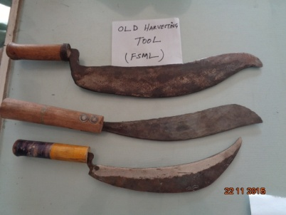
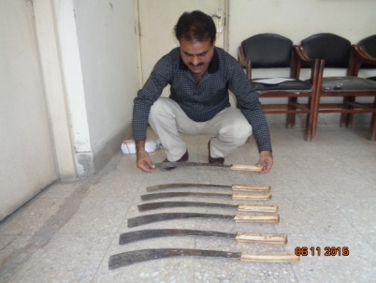
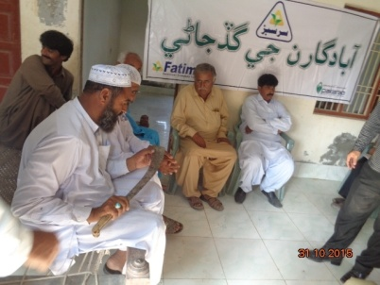
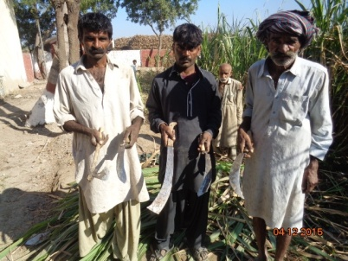
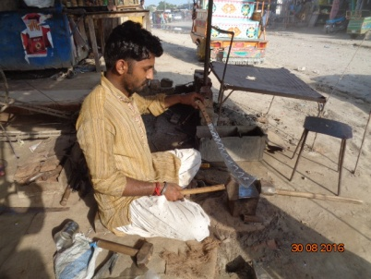
Sugarcane Harvesting Tools used in Sindh Province.
Comparison of Harvesting Tools
Different Type of Sickles
Smart Harvesting Knife
Demonstration in Growers Meeting
Demonstrate Harvesting Tools
Smart Harvesting Knife under Preparation

Slide 13
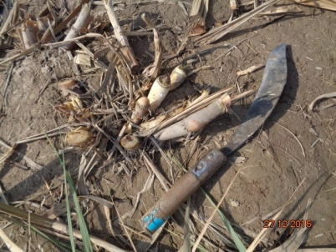
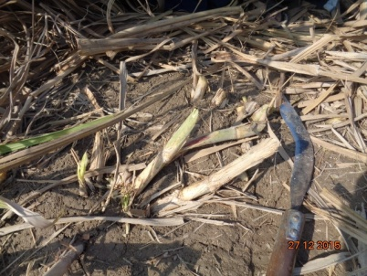
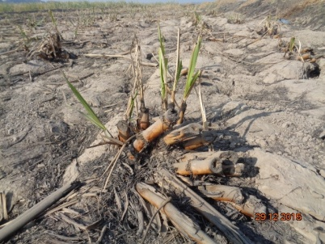
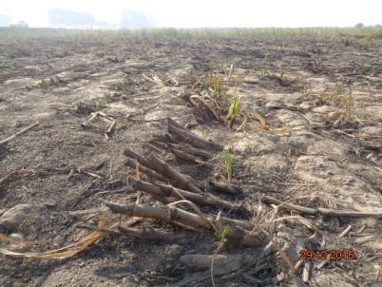
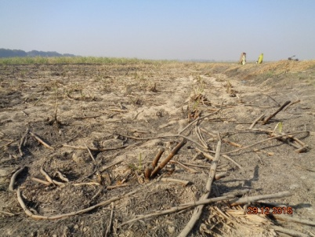
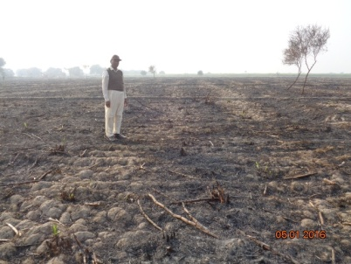
Pictorial View of In-Field Losses
Cane Harvested by Sickle
Cane Harvested by Sickle
Poor Sprouting due to Improper Harvesting
In-Field Loss due to Improper Harvesting
In-Field Losses due to Improper
Harvesting
In-Field Losses

Slide 14
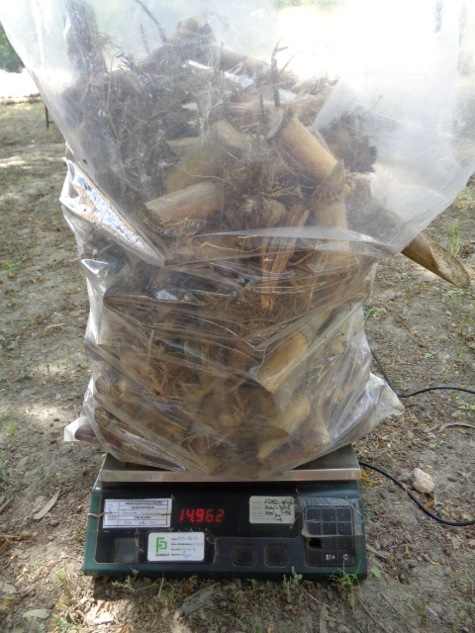
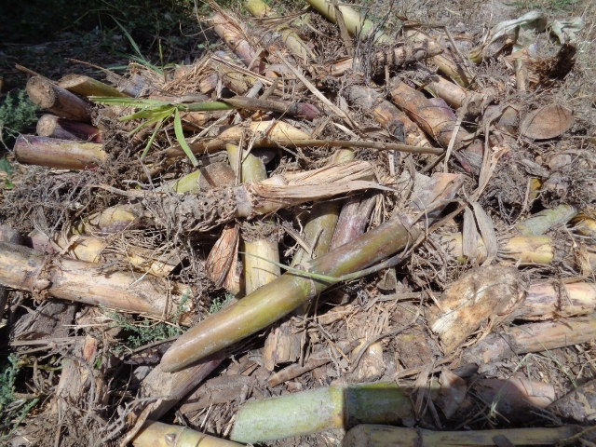
Pictorial View of In-Field Losses

Slide 15
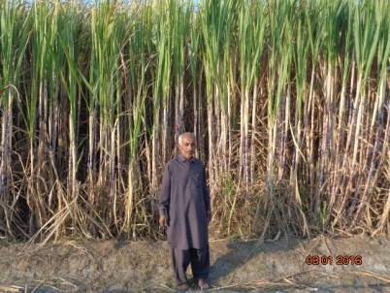
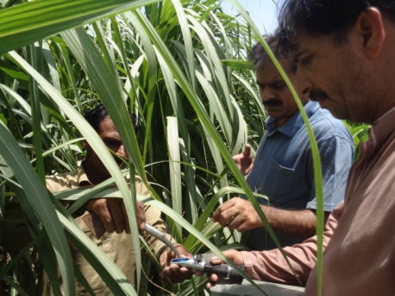
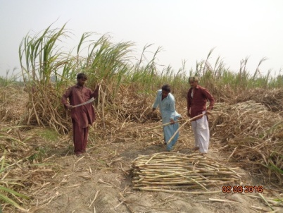
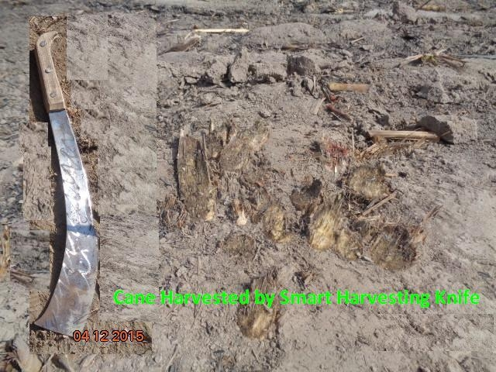
Pictorial View
Ratooning Crop
Maturity Check at Field
Cane Harvested by
Smart Harvesting Knife

Slide 16
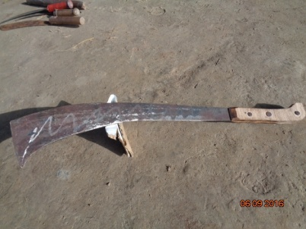
Choose Smart Harvesting Knife
Before cutting sugarcane you need a harvesting Tool. Sugarcane is strong. So sharp cutting blade is necessary to cut the crop properly. A sharp knife is suitable tool for harvesting of sugarcane. Smart harvesting knife with large cutting blade, is your best choice. It can efficiently cut down sugarcane. Cut cane close to ground.
The Smart Harvesting Knife is characterized as:
A hard wood handle 6”.5” inches
Length 22” inches
Deep Curved Blade width 4” inches

Slide 17
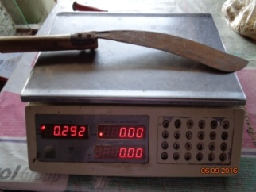
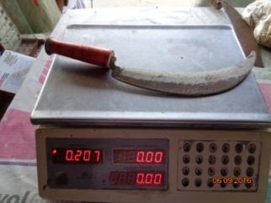
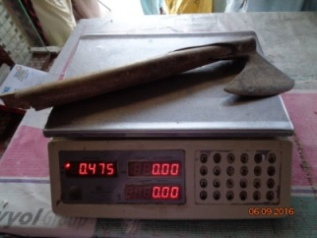
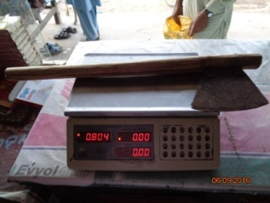
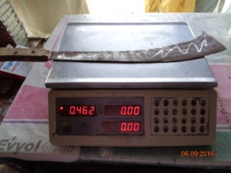
Comparison of Different Harvesting Tools Used in Sindh
Sr.# | Tool | Weight (gram) | Harvesting Efficiency Mds/day per Labour Cutting | Pictures
1 | Big Sickle | 0.292 | 38-45
2 | Small Sickle | 0.207 | 30-38
3 | Axe | 0.475 | 40-50
4 | Long Wood Handle Axe (common used in Punjab & Sindh) | 0.804 | 45-50
5 | Smart Harvesting Knife | 0.462 | 45-55

Slide 18
Efficient Harvesting Programme
The first step towards cane harvesting programme in the crushing season needs information on:
Available quality cane in operational area.
Varietal composition.
Crop classification.
Crop condition.
Quality parameters described.
Periodic juice and analysis of the cane block-wise.
Pest and disease infestation data.

Slide 19
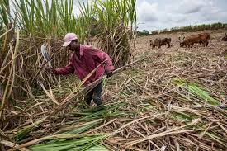
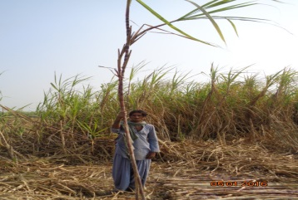
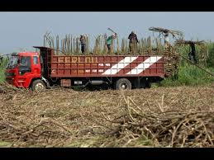
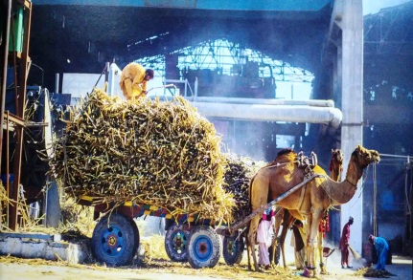
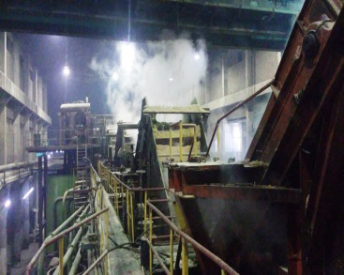
Field Operations
Skilled Labour
Cut Sugarcane
Loading In-Field Vehicles
Transport Sugarcane
Arrive at Mill
Road Network

Slide 20
Sector Wise Infield Losses Due to Improper Harvesting
Sr. # | Sector | Surveyed No. of Fields | In-field Losses Per Acre (Mds)
1 | Gate | 13 | 19
2 | Jhan Mori | 12 | 17
3 | Digh Mori | 10 | 14
4 | Chandia | 12 | 14.5
5 | Khokhar | 10 | 19.5
6 | Daro Sandi | 09 | 18
 | - | 66 | -
During study, found maximum in-field losses where harvesting was done by Sickle and secondly cut for fodder purpose.
In-field losses recorded 14-19 mds, per acre.

Slide 21
Advantages of the proper harvesting
Yield increased per unit area.
Labour saving.
Additional Sugar Recovery.
Quick and more tillering.
Better Ratooning.
Cost saving per unit area.

Slide 22
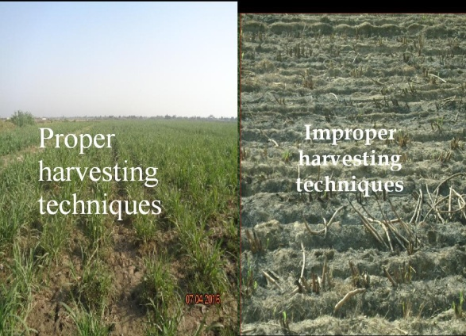

Slide 23
Losses in Sugarcane Weight from Harvesting to Crush
Source: P.W on Agriculture 2010 P-58

Slide 24
Measures To Avoid Staling Losses
Use vigilance in cane supply indent.
Cane harvesting and supply to correspond with crushing capacity of mills.
Capacity and harvesting programme of growers to be planned.
Proper education to growers, on cane harvesting.
Economical and fast cane transportation system.
Less reliance on un-Loading labour.

Slide 25
Harvesting Techniques
To harvest the cane at peak maturity (i.e. avoiding cutting of either over – aged or under aged cane).
Cutting cane from ground level for maximum sugar yield.
De-topping at appropriate height so that green immature tops are eliminated.
Proper cleaning of the cane i.e. removing the extraneous material such as dry leaves – trash and roots etc.
Cut to crush time.
Avoid cane harvesting with Sickle.
To choose the smart harvesting knife which help faster – easier – aggressive and efficient cutting from ground level.

Slide 26
Importance of Ratoon Crop
Ratoon crop contribution ranges about 45% to 55% of the total sugarcane acreage in Pakistan.
Saving in initial cost.
Generally 1-3 Ratoons are economically viable (40%-45% cost saving).
Saves time, quickly establishes, matures early
(in 10-11 months) and save nos: of irrigations.
Early start of growth and rapid sprouting of seed with early cane stalk formation.

Slide 27
Ratooning Trend To FSML Area
Keeping the Ratoon maximum up to three years. Which is the reason reduction in
acreage in current year.
Now we are propagating atleast four Ratoons.

Slide 28
Production cost comparison between Autumn and Ratoon Crop / acre
Autumn Crop Amount Ratoon Crop
(Amount)
Field Operations
Land preparation Rs.15,300.00 –
Seed 120 mds @ Rs.225/- per md Rs.27,000.00 –
Plantation charges @Rs.2,000/- per acre Rs. 2,000.00 –
Ratoon Stubble Shaver Application – Rs. 725.00
Other Field Operations (common) Rs. 53,150.00 Rs.53,150.00
Total Rs. 97,450.00 Rs.53,875.00 (Saving Rs.43,575)
Ratoon Crop if maintain properly the cost of production of sugarcane further reduces.

Slide 29
Potential of different Varieties and their Ratoon-ability in FSM area
Variety Ratooning Yield Potential (t / hac:)
Thatta-10 3-4 Ratooning 118.50
CPF-237 2-3 Ratooning 128.50
CPF-246 2-3 // 137.32
SPF-234 1 // 109.68
Thata-2109 1-2 // 117.00
US-633 1-2 // 118.50
US-718 1-3 // 127.70
HOTH-300 1-2 // 118.56
US-127 1-2 // 121.50
SPSG-26 Poor Ratooning 49.50
BF-129 // 54.34
Discourage varieties SPSG-26 and BF-129.

Slide 30
Constraints of Sugarcane Ratoon
Poor plant population due to less seed rate, gaps and poor sprouting.
Improper harvesting.
Poor microbial activities.
Attack of Pest and Diseases.
Improper harvesting time.
Stubble damage during harvesting and Farm Traffic.
Maintaining Ratoon of poor Ratooning Varieties.

Slide 31
Better Ratooning Management
Measures to be taken by Growers for better Ratoon crop.
To introduce latest’s Ratoon Management practices (LRMP).
i.e proper harvesting, stubble shaving, gap filling and trash mulching.
Proper training of farmers at field.
Co-ordinated village meetings.
To promote Ratoon stubble shaver technology.
Reduce unnecessary movement of heavy duty machinery in cane fields.
Adopt latest harvesting techniques.
Maintaining Ratoon is the key of improvement in Growers economy.

Slide 32
Conclusion
Harvesting of sugarcane should be done at a proper time at peak maturity. Latest harvesting techniques should be used to avoid weight losses and better Ratooning. Regular training of field labours is required in supervision of the skilled labours to avoid unnecessary loss to the Grower. Ratooning is mainly based on harvested crop. Therefore harvesting techniques is of paramount importance for maintainability of good Ratoon crop. Ratooning is regular practice among all cane growing countries and need to be emphasized and propagated to improve the income of the cane growers.

Slide 33
Acknowledgment
Acknowledgments are duly extend to:
Mr. Omar Amin Bawany Chairman,
Mr. Ahmed Ali Bawany Chief Executive Officer
Mr. Riaz Javed Suleri Resident Director
for their encouragement and support to present this paper.
Thanks are extended to Mr. Mir Hussain Khan D.G.M (Cane),
Mr. Mohammad Ashique A.G.M (Cane), Mr. Adeel Naveed Cane Manager and Mr. Mohammad Moosa, Computer Operator for co-operation and collection of data with printing the menu script.

Slide 34
Reference
Solomon S, Shrivastava AK, Yadave RL (2007) strategies to minimize post harvest losses in sugarcane proceeding of the 68th Annual Convention of STAI, India: 112-121.
Malik K.B and Gurmani, M.H (1999) Sugarcane production problems of lower sindh and measures to combat the problems.
Baba K.M (1989) economics of resources use in agriculture.
Y.J Minhas (2010) agriculture work shop proceeding page 58- production of Quality Cane.
Dr. S.A. and K.B Malik (2010) Agri: workshop proceeding page-59
Best Agronomic Practices for Sugarcane Production. (AC14103-7) P-20

Slide 35
Thanks

